Slide 1

Frontiers of Network Science
Fall 2023
Class 13 Robustness I
(Chapter 8 in Textbook)
based on slides by
Albert-László Barabási
and Roberta Sinatra
Boleslaw Szymanski
www.BarabasiLab.com

Slide 2
Apply the Malloy-Reed Criteria to an Erdos-Renyi Network
A giant cluster exists if each node is connected to at least two other nodes.
κ>2: a giant cluster exists;
κ<2: many disconnected clusters;
Malloy-Reed; Cohen et al., Phys. Rev. Lett. 85, 4626 (2000).

Slide 3
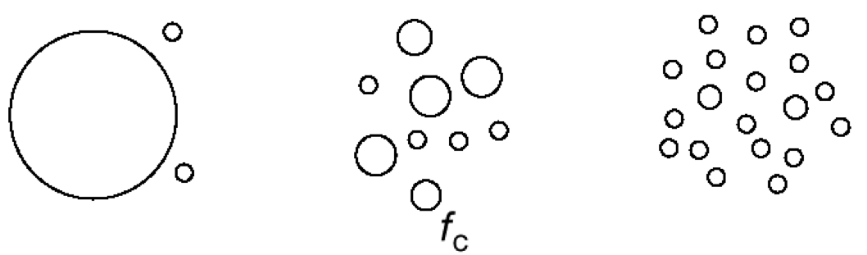
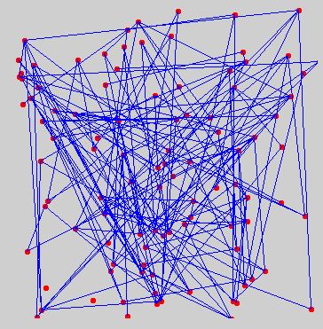
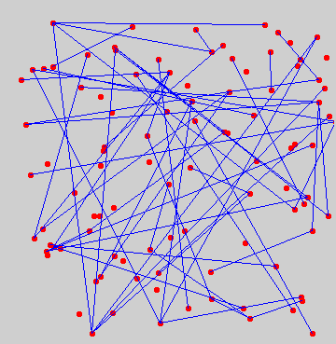
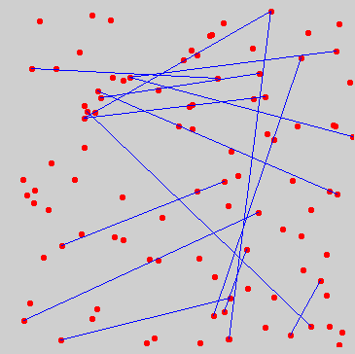
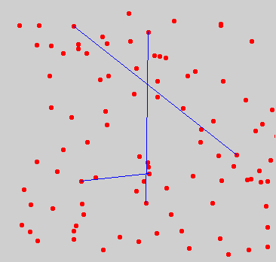
RANDOM NETWORK:
DAMAGE IS MODELED AS AN INVERSE PERCOLATION PROCESS
f = fraction of removed nodes
S
Component
structure
Graph
f=0
f_{c} =(1-1/N)/<k>
f=1/<k>
<k>=N-1
k_{c} : <k>=1
<k>->0
(Inverse percolation phase transition)

Slide 4
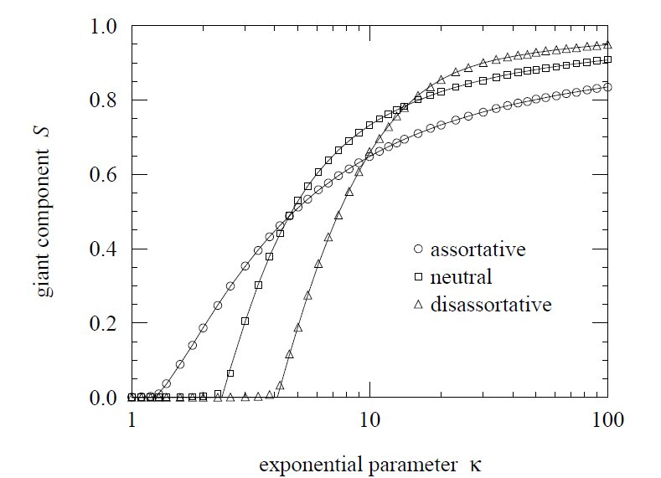
FINAL REMARKS: EFFECT OF ASSORTATIVE MIXING: PERCOLATION
M. E. J. Newman, Phys. Rev. Lett. 89, 208701 (2002)

Slide 5
BREAKDOWN THRESHOLD FOR ARBITRARY P(k)
Problem: What are the consequences of removing a fraction f of all nodes?
At what threshold f_{c} will the network fall apart (no giant component)?
Random node removal changes
the degree of individual nodes [k → k’ ≤k]
the degree distribution [P(k) → P’(k’)]
A node with degree k will loose some links and become a node with degree k’ with probability:
The prob. that we had a k degree node was P(k), so the probability that we will have a new node with degree k’ :
Remove k-k’ links, each with probability f
Leave k’ links untouched, each with probability 1-f
Let us asume that we know <k> and <k²> for the original degree distribution P(k)
→ calculate <k’> , <k’²> for the new degree distribution P’(k’).
Cohen et al., Phys. Rev. Lett. 85, 4626 (2000).

Slide 6
BREAKDOWN THRESHOLD FOR ARBITRARY P(k)
Degree distribution after we removed f fraction of nodes.
The sum is done over the triangle shown in the right, so we can replace it with
k=[k’, ∞)
k’
Cohen et al., Phys. Rev. Lett. 85, 4626 (2000).

Slide 7
BREAKDOWN THRESHOLD FOR ARBITRARY P(k)
Degree distribution after we removed f fraction of nodes.
The sum is done over the triangle shown in the right, i.e. we can replace it with
k=[k’, ∞)
k’
Cohen et al., Phys. Rev. Lett. 85, 4626 (2000).

Slide 8
BREAKDOWN THRESHOLD FOR ARBITRARY P(k)
Robustness: we remove a fraction f of the nodes.
At what threshold f_{c} will the network fall apart (no giant component)?
Random node removal changes
the degree of individuals nodes [k → k’ ≤k)
the degree distribution [P(k) → P’(k’)]
κ>2: a giant cluster exists
κ<2: many disconnected clusters
S
Breakdown threshold:
f<f_{c}: the network is still connected (there is a giant cluster)
f>f_{c}: the network becomes disconnected (giant cluster vanishes)
f_{c}
f
Cohen et al., Phys. Rev. Lett. 85, 4626 (2000).

Slide 9
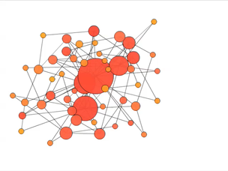
ROBUSTNESS OF SCALE-FREE NETWORKS
Scale-free networks do not appear to break apart under random failures.
Reason: the hubs.
The likelihood of removing a hub is small.
1
S
0
f
1
Albert, Jeong, Barabási, Nature 406 378 (2000)

Slide 10
ROBUSTNESS OF SCALE-FREE NETWORKS
Scale-free networks do not appear to break apart under random failures. Why is that?

Slide 11
ROBUSTNESS OF SCALE-FREE NETWORKS
γ>3: κ is finite, so the network will break apart at a finite f_{c} that depens on K_{min}
γ<3: κ diverges in the N→ ∞ limit, so f_{c} → 1 !!!
for an infinite system one needs to remove all the nodes to break the system.
For a finite system, there is a finite but large f_{c} that scales with the system size as:
Internet: Router level map, N=228,263; γ=2.1±0.1; κ=28 → f_{c}=0.962
AS level map, N= 11,164; γ=2.1±0.1; κ=264 → f_{c}=0.996

Slide 12
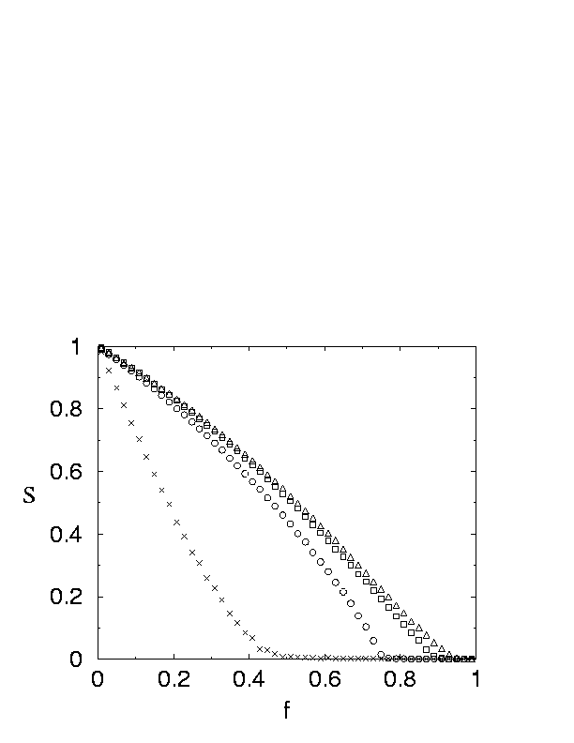
NUMERICAL EVIDENCE
Scale-free random graph with
Cohen et al., Phys. Rev. Lett. 85, 4626 (2000).
Infinite scale-free networks with do not break down under
random node failures.

Slide 13
SIZE OF THE GIANT COMPONENT DURING RANDOM DAMAGE –WITHOUT PROOF-
S: size of the giant component, f fraction of randomly removed nodes, not damage for f<f_{c}
γ>4: S≈f-f_{c} (similar to that of a random graph)
3>γ>4: S≈(f-f_{c})^{1/(γ-3)}
γ<3: f_{c} =0 and S≈f^{1+1/(3-γ)}
R. Cohen, D. ben-Avraham, S. Havlin,
Percolation critical exponents in scale-free networks
Phys. Rev. E 66, 036113 (2002);
See also: Dorogovtsev S, Lectures on Complex Networks, Oxford, pg44

Slide 14
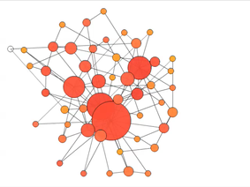
Achilles’ Heel of scale-free networks
1
Attacks
Failures
S
γ ≤ 3 : f_{c}=1
(R. Cohen et al PRL, 2000)
0
f_{c}
1
f
Albert, Jeong, Barabási, Nature 406 378 (2000)

Slide 15
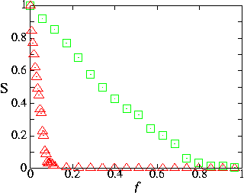
INTERNET’S ROBUSTNESS TO RANDOM FAILURES
failure
attack
Internet
R. Albert, H. Jeong, A.L. Barabasi, Nature 406 378 (2000)
Internet: Router level map, N=228,263; γ=2.1±0.1; κ=28 → f_{c}=0.962
AS level map, N= 11,164; γ=2.1±0.1; κ=264 → f_{c}=0.996
Internet parameters: Pastor-Satorras & Vespignani, Evolution and Structure of the Internet: Table 4.1 & 4.4

Slide 16
Attack threshold for arbitrary P(k)
Attack problem: we remove a fraction f of the hubs.
At what threshold f_{c} will the network fall apart (no giant component)?
Hub removal changes
the maximum degree of the network [K_{max} → K’_{max} ≤K_{max})
the degree distribution [P(k) → P’(k’)]
A node with degree k will loose some links because some of its neighbors will vanish.
Claim: once we correct for the changes in K_{max} and P(k),we are back to the robustness problem.
That is, attack is nothing but a robusiness of the network with a new K_{max} and P(k).
Cohen et al., Phys. Rev. Lett. 85, 4626 (2000).

Slide 17
Attack threshold for arbitrary P(k)
Attack problem: we remove a fraction f of the hubs.
the maximum degree of the network [K_{max} → K’_{max} ≤K_{max}) `
If we remove an f fraction of hubs, the maximum degree changes:
As K’_{max} ≤K_{max}
we can ignore
the K_{max} term
← The new maximum degree after removing f fraction of the hubs.
Cohen et al., Phys. Rev. Lett. 85, 4626 (2000).

Slide 18
Attack threshold for arbitrary P(k)
Attack problem: we remove a fraction f of the hubs.
the degree distribution changes [P(k) → P’(k’)]
A node with degree k will loose some links because some of its neighbors will vanish.
Let us calculate the fraction of links removed ‘randomly’ , f’, as a consequence of we removing f fraction of hubs.
as K’_{max} ≤K_{max}
For γ→2, f’→1, which means that even the removal of a tiny fraction of hubs will destroy the network. The reason is that for γ=2 hubs dominate the network
Cohen et al., Phys. Rev. Lett. 85, 4626 (2000).

Slide 19
Attack threshold for arbitrary P(k)
Attack problem: we remove a fraction f of the hubs.
At what threshold f_{c} will the network fall apart (no giant component)?
Hub removal changes
the maximum degree of the network [K_{max} → K’_{max} ≤K_{max})
the degree distribution [P(k) → P’(k’)]
A node with degree k will loose some links because some of its neighbors will vanish.
Claim: once we correct for the changes in K_{max} and P(k), we are back to the robustness problem.
That is, attack is nothing but a robustness of the network with a new K’_{max} and f’.
Cohen et al., Phys. Rev. Lett. 85, 4626 (2000).

Slide 20
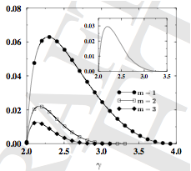
Attack threshold for arbitrary P(k)
Attack problem: we remove a fraction f of the hubs.
At what threshold f_{c} will the network fall apart (no giant component)?
f_{c}
f_{c} depends on γ; it reaches its max for γ<3
f_{c} depends on K_{min} (m in the figure)
Most important: f_{c} is tiny. Its maximum reaches
only 6%, i.e. the removal of 6% of nodes can destroy the network in an attack mode.
Internet: γ=2.1, so 4.7% is the threshold.
Figure: Pastor-Satorras & Vespignani, Evolution and Structure of the Internet: Fig 6.12
Cohen et al., Phys. Rev. Lett. 85, 4626 (2000).

Slide 21
Application: ER random graphs
Consider a random graph with connection probability p such that at least a giant connected component is present in the graph.
S surviving giant component
Find the critical fraction of removed
nodes such that the giant connected
component is destroyed.
The higher the original average degree, Empty squares show S
the larger damage the network can survive. Filled squares l – avg. distance
Q: How do you explain the peak in the average distance?
Minimum
damage

Slide 22
Summary: Achilles’ Heel of scale-free networks
1
Attacks
Failures
S
γ ≤ 3 : f_{c}=1
(R. Cohen et al PRL, 2000)
0
f_{c}
1
f
Albert, Jeong, Barabási, Nature 406 378 (2000)

Slide 23
Summary: Achilles’ Heel of complex networks
failure
attack
Internet
R. Albert, H. Jeong, A.L. Barabasi, Nature 406 378 (2000)

Slide 24
Historical Detour: Paul Baran and Internet
1958
A network of n-ary
degree of connectivity
has n links per node
was simulated
The simulation revealed that networks where n ≥ 3 had a significant increase in resilience against even as much as 50% node loss. Baran's insight gained from the simulation was that redundancy was the key.
Notes:
While working at the RAND Corporation, Paul Baran was assigned the task of designing a "survivable" communications system that could maintain communication between end points in the face of damage from nuclear attack. Using mini-computer technology of the day, Baran and his team developed a simulation suite to test basic connectivity of an array of nodes with varying degrees of linking. That is, a network of n-ary degree of connectivity would have n links per node. The simulation randomly 'killed' nodes and subsequently tested the percentage of nodes who remained connected. The result of the simulation revealed that networks where n >= 3 had a significant increase in resilience against even as much as 50% node loss. Baran's insight gained from the simulation was that redundancy was the key.
As a result of President Eisenhower's Defense Reorganization Act of 1958, there was a major shift in leadership in the Pentagon around the time Baran's work was accepted by the US Air Force and DoD for implementation and testing. When Baran discovered an older Navy admiral would oversee the project he decided the project would be better off sitting on the shelf as reference material, claiming that an 'old analog guy' couldn't grasp what it was the project aimed to accomplish, and thus would likely fail from lack of understanding.
Around the same time when ARPA was developing the idea of an inter-networked set of terminals to share computing resources, among the number of reference materials considered was Paul Baran and the RAND Corporation's On Distributed Communications volumes. The ARPANET was never intended to be a survivable communications network, but some still maintain the myth that it was. Instead, the resilience feature of a packet switched network that uses link-state routing protocols is something we enjoy today in some part from the research done to develop a network that could survive a nuclear attack.
(Source: Wikipedia, Paul Baran)

Slide 25
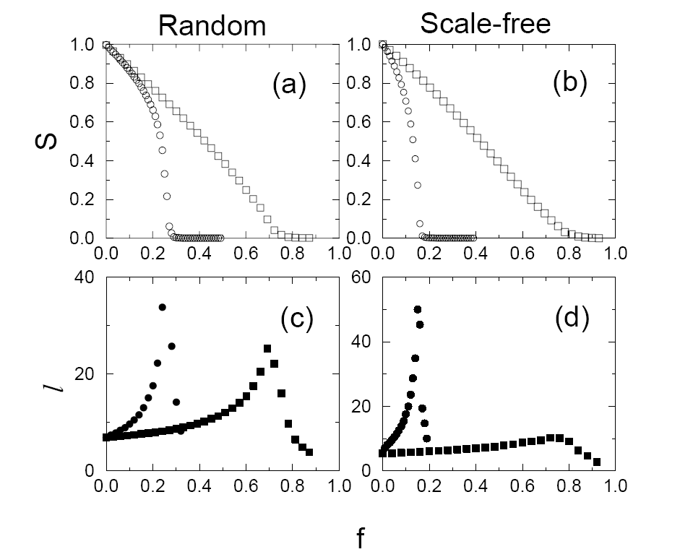
Scale-free networks are more error tolerant, but also more vulnerable to attacks
squares: random failure
circles: targeted attack
S surviving fraction of GC
l average distance
Failures: little effect on the integrity of the network.
Attacks: fast breakdown

Slide 26
Real scale-free networks show the same dual behavior
blue squares: random failure
red circles: targeted attack
open symbols: S (size of surviving
component)
filled symbols: l (average distance)
break down if 5% of the nodes are eliminated selectively (always the highest degree node)
resilient to the random failure of 50% of the nodes.
Similar results have been obtained for metabolic networks and food webs.

Slide 27

Cascades
Potentially large events triggered by small initial shocks
Information cascades
social and economic systems
diffusion of innovations
Cascading failures
infrastructural networks
complex organizations

Slide 28

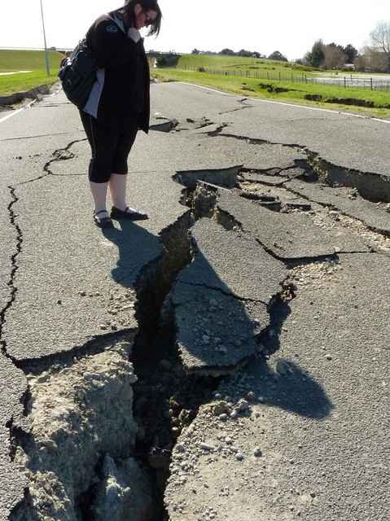
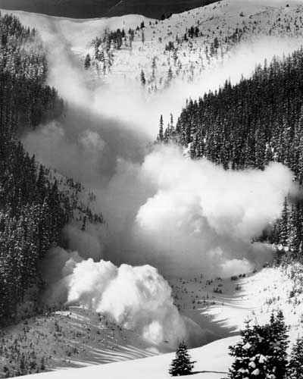
Cascading Failures in Nature and Technology
Blackout
Earthquake
Avalanche
Flows of physical quantities
congestions
instabilities
Overloads
Cascades depend on
Structure of the network
Properties of the flow
Properties of the net elements
Breakdown mechanism

Slide 29
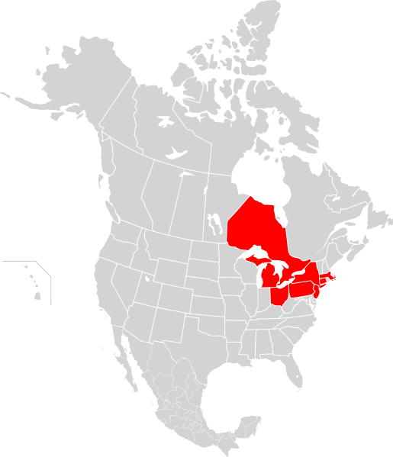
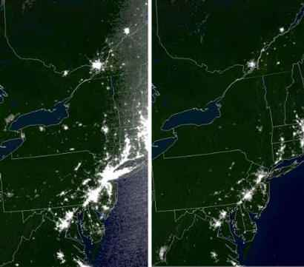
Northeast Blackout of 2003
Origin
A 3,500 MW power surge (towards Ontario) affected the transmission grid at 4:10:39 p.m. EDT. (Aug-14-2003)
Before the blackout After the blackout
Consequences
More than 508 generating units at 265 power plants shut down during the outage. In the minutes before the event, the NYISO-managed power system was carrying 28,700 MW of load. At the height of the outage, the load had dropped to 5,716 MW, a loss of 80%.

Slide 30

Network Science: Robustness Cascades

Slide 31
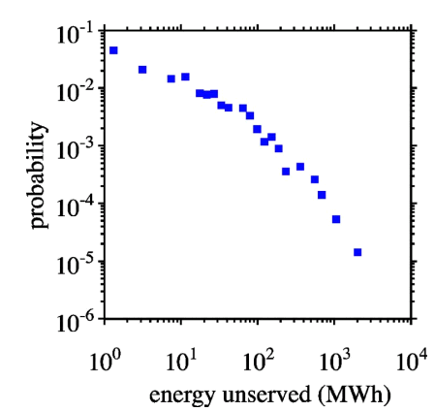
Cascades Size Distribution of Blackouts
Unserved energy/power magnitude (S) distribution
P(S) ~ S ^{−α}, 1< α < 2
Probability of energy unserved during North American blackouts 1984 to 1998.
Source | Exponent | Quantity
North America | 2.0 | Power
Sweden | 1.6 | Energy
Norway | 1.7 | Power
New Zealand | 1.6 | Energy
China | 1.8 | Energy
I. Dobson, B. A. Carreras, V. E. Lynch, D. E. Newman, CHAOS 17, 026103 (2007)

Slide 32
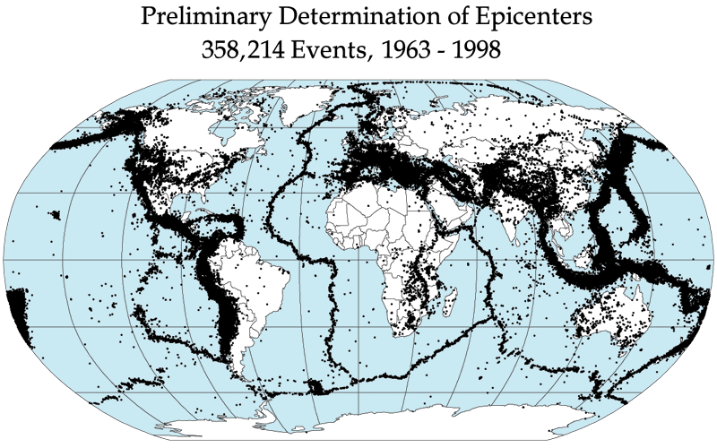
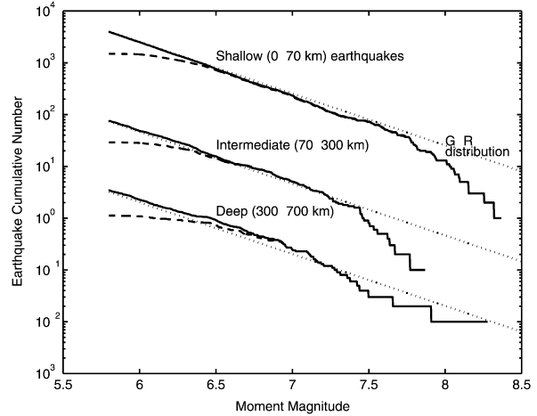
Cascades Size Distribution of Earthquakes
Earthquake size S distribution
Earthquakes during 1977–2000.
P(S) ~ S ^{−α},α ≈ 1.67
Y. Y. Kagan, Phys. Earth Planet. Inter. 135 (2–3), 173–209 (2003)

